Slide 1
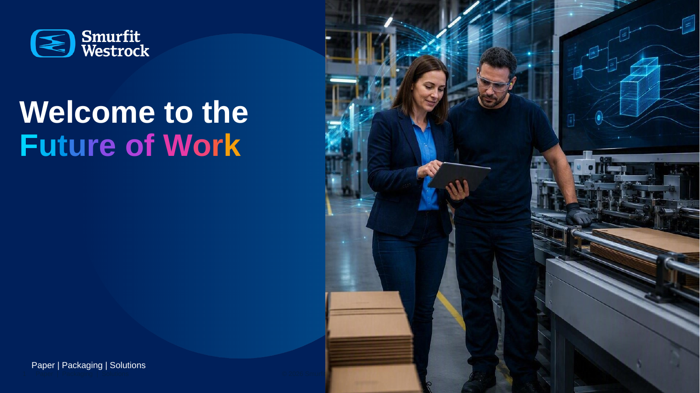
Notes:
[Sources]
- User-provided presentation: 260921 FUTURE OF WORK CONSULTANCY.pptx
- Content direction supplied by Jane Kerrigan in this conversation
[/Sources]

Slide 2
We are the
Future of Work
Consultancy

Slide 3
The Future of Work Consultancy helps employees, teams and business units improve the way they work.
Through expertise in Productivity, Collaboration & Communication, and Business Process Improvement, we combine Microsoft 365 capabilities, practical coaching and consultancy services to deliver measurable improvements in performance, efficiency and employee experience.

Slide 4
Our value to the business
Future of Work
We combine Microsoft 365 expertise, practical coaching and consultancy to improve how employees, teams and business units work.
01
02
03
Performance
Efficiency
Employee experience
Measurable improvements in how employees, teams and business units perform.
Better use of Microsoft 365 to reduce friction and improve everyday work.
Practical coaching and consultancy that help people adopt sustainable change.
Business impact

Slide 5
Our consultancy focuses on three areas
Future of Work
Practical support for the way people work today, with new capabilities built into every service.
01
02
03
Productivity
Collaboration &
Communication
Business Process
Improvement
Helping individuals and teams organise work, manage time and use Microsoft 365 effectively.
Improving how teams connect, share information and work together across locations and functions.
Simplifying recurring work and improving processes using existing tools, automation and built-in intelligence.
Three consultancy domains
Notes:
[Sources]
- User-provided presentation: 260921 FUTURE OF WORK CONSULTANCY.pptx
- Content direction supplied by Jane Kerrigan in this conversation
[/Sources]

Slide 6
How we help the business grow
Future of Work
Three flexible service routes, selected to match the need, scale and level of change.
Training
Build practical skills, confidence and consistent working habits.
1
Webinars and tailored team sessions
Consultancy projects
Understand the challenge, redesign the way of working and support implementation.
2
Focused improvement engagements
1-to-1 coaching
Help people apply the tools to their role, priorities and real work.
3
Personal guidance at the point of need
Flexible service model
Notes:
[Sources]
- User-provided presentation: 260921 FUTURE OF WORK CONSULTANCY.pptx
- Content direction supplied by Jane Kerrigan in this conversation
[/Sources]

Slide 7
Consultancy engagements
Future of Work
For teams and business units with a specific challenge, opportunity or ambition to improve how they work.
1 Discover
2 Design
Clarify the business need, desired outcomes, current workflow, pain points and relevant Microsoft 365 opportunities. Output: shared challenge and scope.
Redesign working practices or processes, select the right Microsoft 365 capabilities and define success measures. Output: future way of working and action plan.
3 Enable
4 Measure and improve
Put the approach into practice with tailored team sessions, guidance, resources and one-to-one coaching. Output: a confident team ready to sustain change.
Review behaviour change, benefits delivered, team feedback and further opportunities. Output: demonstrated value and clear next steps.
From a specific business challenge → to a practical, sustainable improvement
Consultancy engagement

Slide 8
A simple consultancy approach
Future of Work
We start with the business outcome, then combine learning, consulting and coaching to make change stick.
1
2
3
4
5
Understand
Design
Enable
Apply
Improve
Outcome, pain points and current ways of working
A practical improvement plan using the right M365 capabilities
Training, tailored sessions and coaching for the people involved
Support teams as new habits and processes are put into practice
Review results, learn and refine the approach
AI and automation are built into the solution wherever they improve the work. They are not separate services.
Outcome-led engagement
Notes:
[Sources]
- User-provided presentation: 260921 FUTURE OF WORK CONSULTANCY.pptx
- Content direction supplied by Jane Kerrigan in this conversation
[/Sources]

Slide 9
The value we bring
Future of Work
Turning everyday Microsoft 365 use into better business performance.
More productive work
Stronger teamwork
Less time lost to avoidable friction, rework and tool confusion.
Clearer communication, better collaboration and easier knowledge sharing.
Simpler processes
Sustainable capability
More consistent, efficient ways of working using tools already available.
Teams and individuals gain the confidence to keep improving themselves.
From using the tools → to improving the work
Business value
Notes:
[Sources]
- User-provided presentation: 260921 FUTURE OF WORK CONSULTANCY.pptx
- Content direction supplied by Jane Kerrigan in this conversation
[/Sources]

Slide 10
The missing part…

Slide 11
How should we organise to make this work?
Future of Work
A discussion to surface the choices — not a proposed structure.
Ownership/team organisation/intake
Access & priorities
Where should accountability sit, and who needs a voice in decisions?
How should people engage the consultancy, and how should demand be prioritised?
Delivery model
Learning & value
What should be central, embedded in the business or delivered through other teams?
How should we judge value, learn from delivery and adapt the model over time?
What would make this workable in practice — and what could get in the way?
Discussion prompt

Slide 12
How we measure
Future of Work
Consultancy value
Evidence that work became
easier, faster and more effective
Notes:
[Sources]
- User-provided presentation: Future_of_Work_Consultancy_Operating_Model 1.pptx
- Measurement framework developed from the user-provided consultancy model and conversation
[/Sources]

Slide 13
Measurement principles
Measure the change in work
Not only how many people attended or which buttons they clicked.
Start with a baseline
Use more than one signal
Be proportionate
Capture the current time, steps, pain points, confidence and behaviour before the intervention.
Combine platform data, short surveys, observation, process evidence and stakeholder feedback.
A webinar needs a light measure. A consultancy project needs defined baselines, owners and benefits.
Separate influence from proof
Measure adoption in context
Tell the value story
Describe contribution honestly. Do not claim that the consultancy alone caused a broad business result.
Tool usage matters only when it demonstrates a better working behaviour or supports an agreed outcome.
Pair a small number of comparable measures with concrete examples from teams and processes.
Measurement principles
Notes:
[Sources]
- User-provided presentation: Future_of_Work_Consultancy_Operating_Model 1.pptx
- Measurement framework developed from the user-provided consultancy model and conversation
[/Sources]

Slide 14
Our value framework
Four levels of evidence
Each level answers a different question. Together they create a credible line from activity to value.
1
2
3
4
1 Reach
2 Capability
3 Behaviour
4 Outcome
Who did we help?
What improved in people’s ability?
What changed in the work?
What value did the change create?
Attendees • teams • functions • sites • coaching sessions
Confidence • knowledge • skills • team maturity • manager readiness
New practices • reduced steps • shared working • automation used
Time released • cycle time • quality • risk • employee experience
Reach is useful. Behaviour and outcomes are where consultancy value becomes visible.
Four levels of evidence
Notes:
[Sources]
- User-provided presentation: Future_of_Work_Consultancy_Operating_Model 1.pptx
- Measurement framework developed from the user-provided consultancy model and conversation
[/Sources]

Slide 15
Measures by consultancy domain
What we can measure in practice
Choose measures that match the specific business challenge and the agreed improvement.
Productivity
Collaboration & Communication
Business Process Improvement
• Time required for a recurring task
• Meeting hours, duration or preparation effort
• Rework, duplication or avoidable searching
• Confidence using the agreed M365 practices
• Information found first time
• Use of shared spaces instead of attachments
• Clarity of ownership and communication channels
• Team experience of meetings and knowledge sharing
• Number of manual steps or hand-offs
• End-to-end cycle time
• Errors, rework and exception volume
• Automation usage and successful completion
Example evidence
Task diary, pulse survey, calendar analysis, before-and-after observation
Example evidence
Team survey, channel/file patterns, meeting review, stakeholder interviews
Example evidence
Process map, system records, sample timing, quality or service data
Domain measures
Notes:
[Sources]
- User-provided presentation: Future_of_Work_Consultancy_Operating_Model 1.pptx
- Measurement framework developed from the user-provided consultancy model and conversation
[/Sources]

Slide 16
Measurement by service route
Apply the right level of measurement
The effort spent measuring should be proportionate to the service and likely business value.
Service
Depth
Timing
Evidence collected
Success test
Webinars
Light
Immediately + 4–6 weeks
Registration and attendance • one practical learning question • confidence or intention • short follow-up pulse
People can identify and apply one useful change.
Tailored team sessions
Standard
Before + immediately + 4–8 weeks
Team baseline • agreed practices • confidence • manager check-in • evidence of changed team behaviour
The team adopts the agreed working practice.
Consultancy projects
Detailed
Baseline + milestones + close + benefits review
Defined measures • process evidence • M365 signals • stakeholder review • benefit owner • case study
The agreed operational or experience outcome improves.
1-to-1 coaching
Light
At close + optional follow-up
Goal achieved • confidence • action agreed • short outcome statement or example of application
The individual resolves a real work need and can repeat it.
Proportionate measurement
Notes:
[Sources]
- User-provided presentation: Future_of_Work_Consultancy_Operating_Model 1.pptx
- Measurement framework developed from the user-provided consultancy model and conversation
[/Sources]

Slide 17
A practical engagement scorecard
Agree success before delivery begins
One page provides enough discipline without turning every engagement into a research programme.
Business challenge
What needs to become easier, faster or more effective?
Example: monthly reporting process
Baseline
What happens today, and what evidence is available?
Baseline
6 hours per month • 9 manual steps • frequent corrections
Target
A shared, repeatable reporting process with clear ownership
Target behaviour
What should people or teams do differently?
Behaviour
Team uses the agreed source, template and automated steps
Measures
Select 3–5 indicators across capability, behaviour and outcome.
Outcome
45 minutes per month • 3 manual steps • fewer corrections
Benefit owner
Who in the business confirms the result and sustains it?
Evidence
Timing sample • process map • owner verification • team feedback
Use real baseline and outcome data. The figures above illustrate the scorecard structure only.
Engagement scorecard
Notes:
[Sources]
- User-provided presentation: Future_of_Work_Consultancy_Operating_Model 1.pptx
- Measurement framework developed from the user-provided consultancy model and conversation
[/Sources]

Slide 18
How we report consultancy value
A small dashboard plus strong work stories
Aggregate comparable measures, while preserving the context that explains why the improvement matters.
Monthly operating view
Every work story should answer five questions
Demand • services delivered • people and teams reached • active engagements • completion and follow-up rate
1
What was getting in the way?
2
What did the consultancy do?
Quarterly value view
3
What changed in the way people work?
Capability shifts • changed behaviours • completed benefits • examples by domain • lessons for the service model
4
What evidence shows improvement?
5
What will sustain or scale the change?
Annual portfolio view
Patterns of demand • recurring friction • scalable improvements • priorities for the next year
A credible statement: “We contributed to this improvement alongside the business team.”
Reporting and learning
Notes:
[Sources]
- User-provided presentation: Future_of_Work_Consultancy_Operating_Model 1.pptx
- Measurement framework developed from the user-provided consultancy model and conversation
[/Sources]

